Slide 1
Error Handling

Slide 2
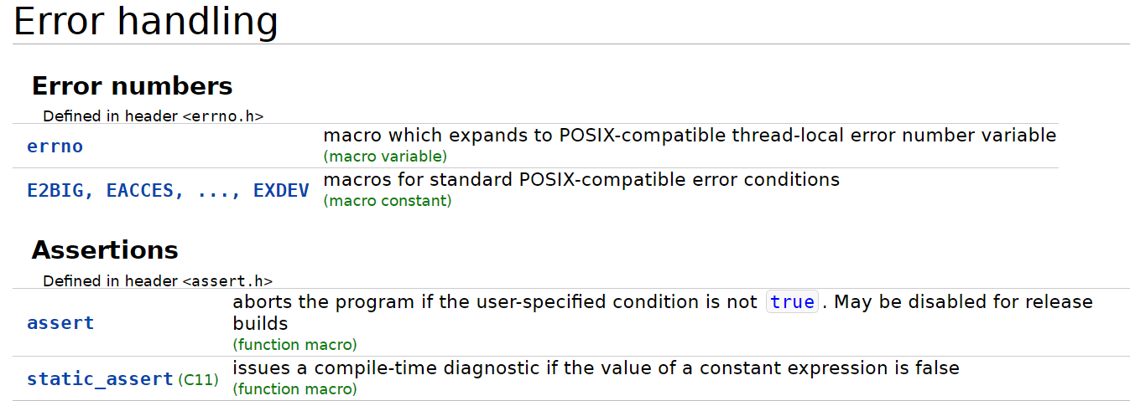
Checking for errors
assert macro
Testing errno variable
Perror and strerror functions
POSIX: Portable Operating System Interface

Slide 3
assert
void assert (scalar expression);
If false,
assert outputs implementation-specific diagnostic information on the standard error output and
calls abort()
Diagnostic information include
the text of expression, the values of the standard macros __FILE__, __LINE__, and the predefined variable __func__. (since C99)

Slide 4
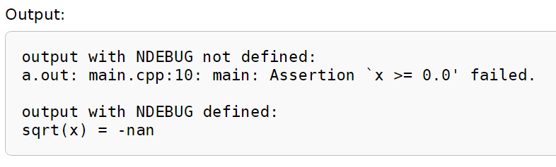
#include <stdio.h>
// uncomment to disable assert()
// #define NDEBUG
#include <assert.h>
#include <math.h>
int main(void)
{
double x = -1.0;
assert(x >= 0.0);
printf("sqrt(x) = %f\n", sqrt(x));
return 0;
}

Slide 5
assert
Disadvantage
Slightly increases the running time of a program because of the extra check it performs
Use assert during testing, then disable it when the program is finished
Disabling assert: define the macro NDEBUG prior to including the <assert . H> header:
#define NDEBUG
#inc1ude <assert.h>

Slide 6
errno
errno a modifiable lvalue of type int
the value of errno is set to one of the error codes listed in <errno.h>
Several standard library functions indicate errors by writing positive integers to errno
Library functions perror and strerror can be used to obtain textual descriptions of the error conditions that correspond to the current errno value.

Slide 7
int main(void) {
printf("MATH_ERRNO is %s\n", math_errhandling & MATH_ERRNO ? "set" : "not set");
errno = 0;
1.0/0.0;
show_errno();
errno = 0;
acos(+1.1);
show_errno();
errno = 0;
log(0.0);
show_errno();
errno = 0;
sin(0.0);
show_errno();
}
#include <stdio.h>
#include <math.h>
#include <errno.h>
void show_errno(void)
{
if(errno==EDOM) printf("domain error");
if(errno==EILSEQ) printf("illegal sequence");
if(errno==ERANGE) printf("pole or range error");
if(errno==0) printf("no error");
printf(" occurred\n");
}
MATH_ERRNO is set
pole or range error occurred
domain error occurred
pole or range error occurred
no error occurred

Slide 8
Error numbers
Defined in header <errno.h>
EDOM Mathematics argument out of domain of function
EILSEQ Illegal byte sequence
ERANGE Result too large

Slide 9
#include <stdio.h>
#include <math.h>
#include <errno.h>
#include <string.h>
int main(void)
{
errno = 0;
printf("log(-1.0) = %f\n", log(-1.0));
printf("%s\n\n",strerror(errno));
errno = 0;
printf("log(0.0) = %f\n", log(0.0));
printf("%s\n",strerror(errno));
}
log(-1.0) = nan
Numerical argument out of domain
log(0.0) = -inf
Numerical result out of range
nan
inf
Not a number
infinity

